Slide 1
Facial Recognition Drawer Unlock System – AI Model
Implementing CNN-based Face Verification on the XIAO ESP32-S3 Sense

Slide 2
System Overview
Transmitter: XIAO ESP32-S3 Sense processes live video feeds and runs Convolutional Neural Networks (CNNs) locally.
Receiver: ESP32-S3 DevKit manages high-voltage (12V) relay logic to actuate the solenoid lock.
Communication: Low-latency, peer-to-peer ESP-NOW protocol.
Objective: To design a secure, router-independent drawer lock actuated by live biometric facial verification.

Slide 3
The AI Engine: ESP-WHO Framework
Bringing Computer Vision to Microcontrollers
What is it? ESP-WHO is an active computer vision framework designed by Espressif specifically for resource-constrained IoT devices.
Architecture: It relies on a pipeline of lightweight AI models optimized for the ESP32-S3’s vector instructions.
Memory Utilization: We configured the system using the "Huge APP" partition and allocated the heavy matrix multiplications to the board's OPI PSRAM.

Slide 4
AI Phase 1 - Face Detection & Alignment
Finding the Face in the Frame
Detection (MTCNN): The system first uses a Multi-task Cascaded Convolutional Network to scan the 1600x1200 (UXGA) frame for human facial structures.
Feature Extraction: It identifies key landmarks: the eyes, nose, and mouth corners.
Alignment: The image is mathematically cropped, scaled, and rotated so the face is standardized, removing background noise and variations in camera angle.

Slide 5
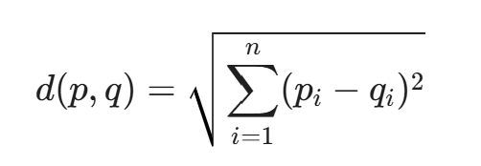
AI Phase 2 - Biometric Encoding
Converting Biology to Mathematics
The Embedding: The aligned face is passed through a FaceNet-lite model, which strips away the visual image and outputs a highly compressed 1-Dimensional Feature Vector (an array of numbers).
Verification: To match a live face against our enrolled faces, the ESP32 calculates the Euclidean distance between the two vectors in high-dimensional space:
The Threshold: If the distance, d, is below a strict mathematical threshold, the model outputs a "Match."

Slide 6
System Initialization & Web Server Setup
Preparing the Environment
Wi-Fi Connection: Upon initial boot, the XIAO ESP32- S3 Sense connects to a standard local Wi-Fi network. Note: Wi-Fi is only required for this initial setup phase.
Hosting the Portal: The XIAO spins up a local asynchronous web server. The HTML/CSS and JavaScript for the user interface are stored directly in the C++ code as compressed hex arrays.
Camera Driver: The OV2640 camera sensor is initialized via esp_camera_init(), piping raw JPEG frames directly to the web UI over HTTP.

Slide 7
The Enrollment Process
Training the Edge Device
Access: The user accesses the board's local IP address via a phone or laptop browser.
Data Capture: Clicking "Enroll Face" triggers the ESP-WHO model to capture 5 to 10 consecutive frames of the user's face.
Averaging: The model calculates the mathematical average of these feature vectors to create a robust, single baseline profile.
Storage: This profile is assigned a discrete ID (e.g., "Subject 0") and stored securely in the board's PSRAM (or Flash memory for permanent retention).

Slide 8
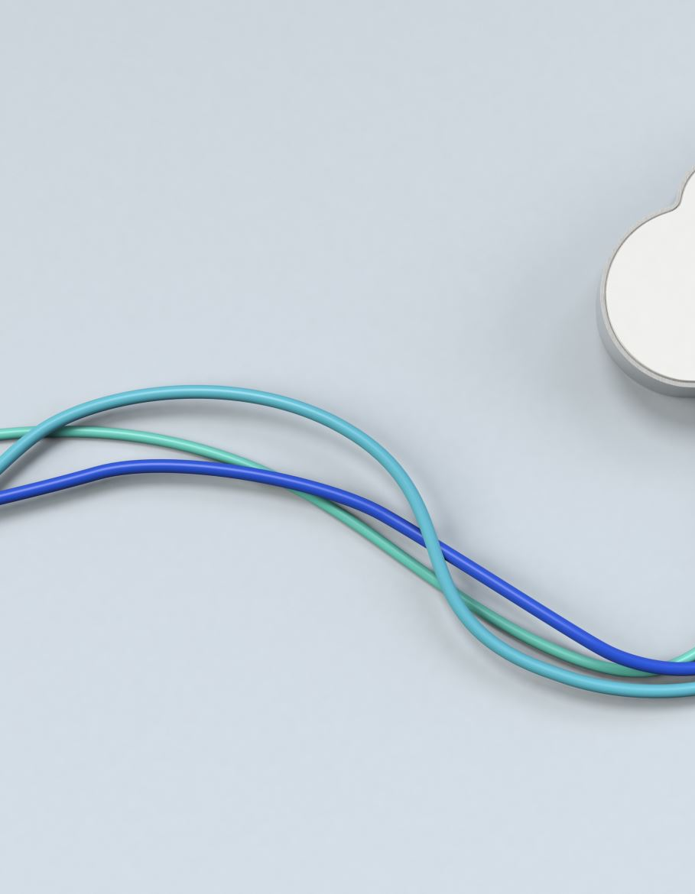
Operational Mode: Transitioning to ESP-NOW
Removing connection from the Router
Wi-Fi Disconnect: Once the face is enrolled, the system no longer needs the web portal or the local Wi-Fi router.
ESP-NOW Activation: The system shifts to ESP-NOW, a connectionless Wi-Fi communication protocol utilizing the 2.4GHz band.
The Trigger: When a recognized face is detected, the AI script interrupts standard operation and fires a lightweight, encrypted "UNLOCK" payload directly to the Receiver's specific MAC Address.

Slide 9
Receiver Actuation & Hardware Safety
Safely Translating Logic to Physical Force
The Listener: The Receiver (ESP32-S3 DevKit) constantly listens via an onDataRecv callback function.
The Translation: Upon verifying the "UNLOCK" string, the DevKit drives a GPIO pin HIGH, triggering a 5V relay.
Hardware Protection: The relay closes the 12V circuit to retract the lock. A 1N4007 Flyback Diode safely dissipates the inductive voltage spike when the solenoid de-energizes, protecting the microcontroller.

Slide 10
Conclusion
Project Summary & Future Iterations
Current State: Fully functional, decentralized biometric lock operating completely on edge AI.
Future Upgrades: * Migrating biometric profiles from volatile PSRAM to non-volatile SPIFFS/Flash.
Implementing Deep Sleep interrupt triggers (via tactile button) to optimize the 3.7V LiPo battery life.

Slide 11
Technical Challenges
Development Environment Constraints
The Roadblock: Encountered critical configuration issues within the Arduino IDE, preventing the successful installation and compilation of facial recognition libraries.
Technical Context: The required Convolutional Neural Network (CNN) models and camera drivers rely on a complex web of specific ESP32 board support packages, which proved unstable in our current IDE setup.
Project Impact: This toolchain instability temporarily halted the deployment of the on-device biometric enrollment and verification logic to the Transmitter Unit (XIAO ESP32-S3 Sense).
Strategic Pivot: Moving forward, the proposed solution is that we may migrate the development environment from the Arduino IDE to the official Espressif IoT Development Framework (ESP-IDF), which offers native, robust dependency management for complex AI workloads.

